Slide 1
The tourism brochure group
Kato Kaho
Sugitani Yurie
Teraoka Maria
Kawaguchi Yusei

Slide 2
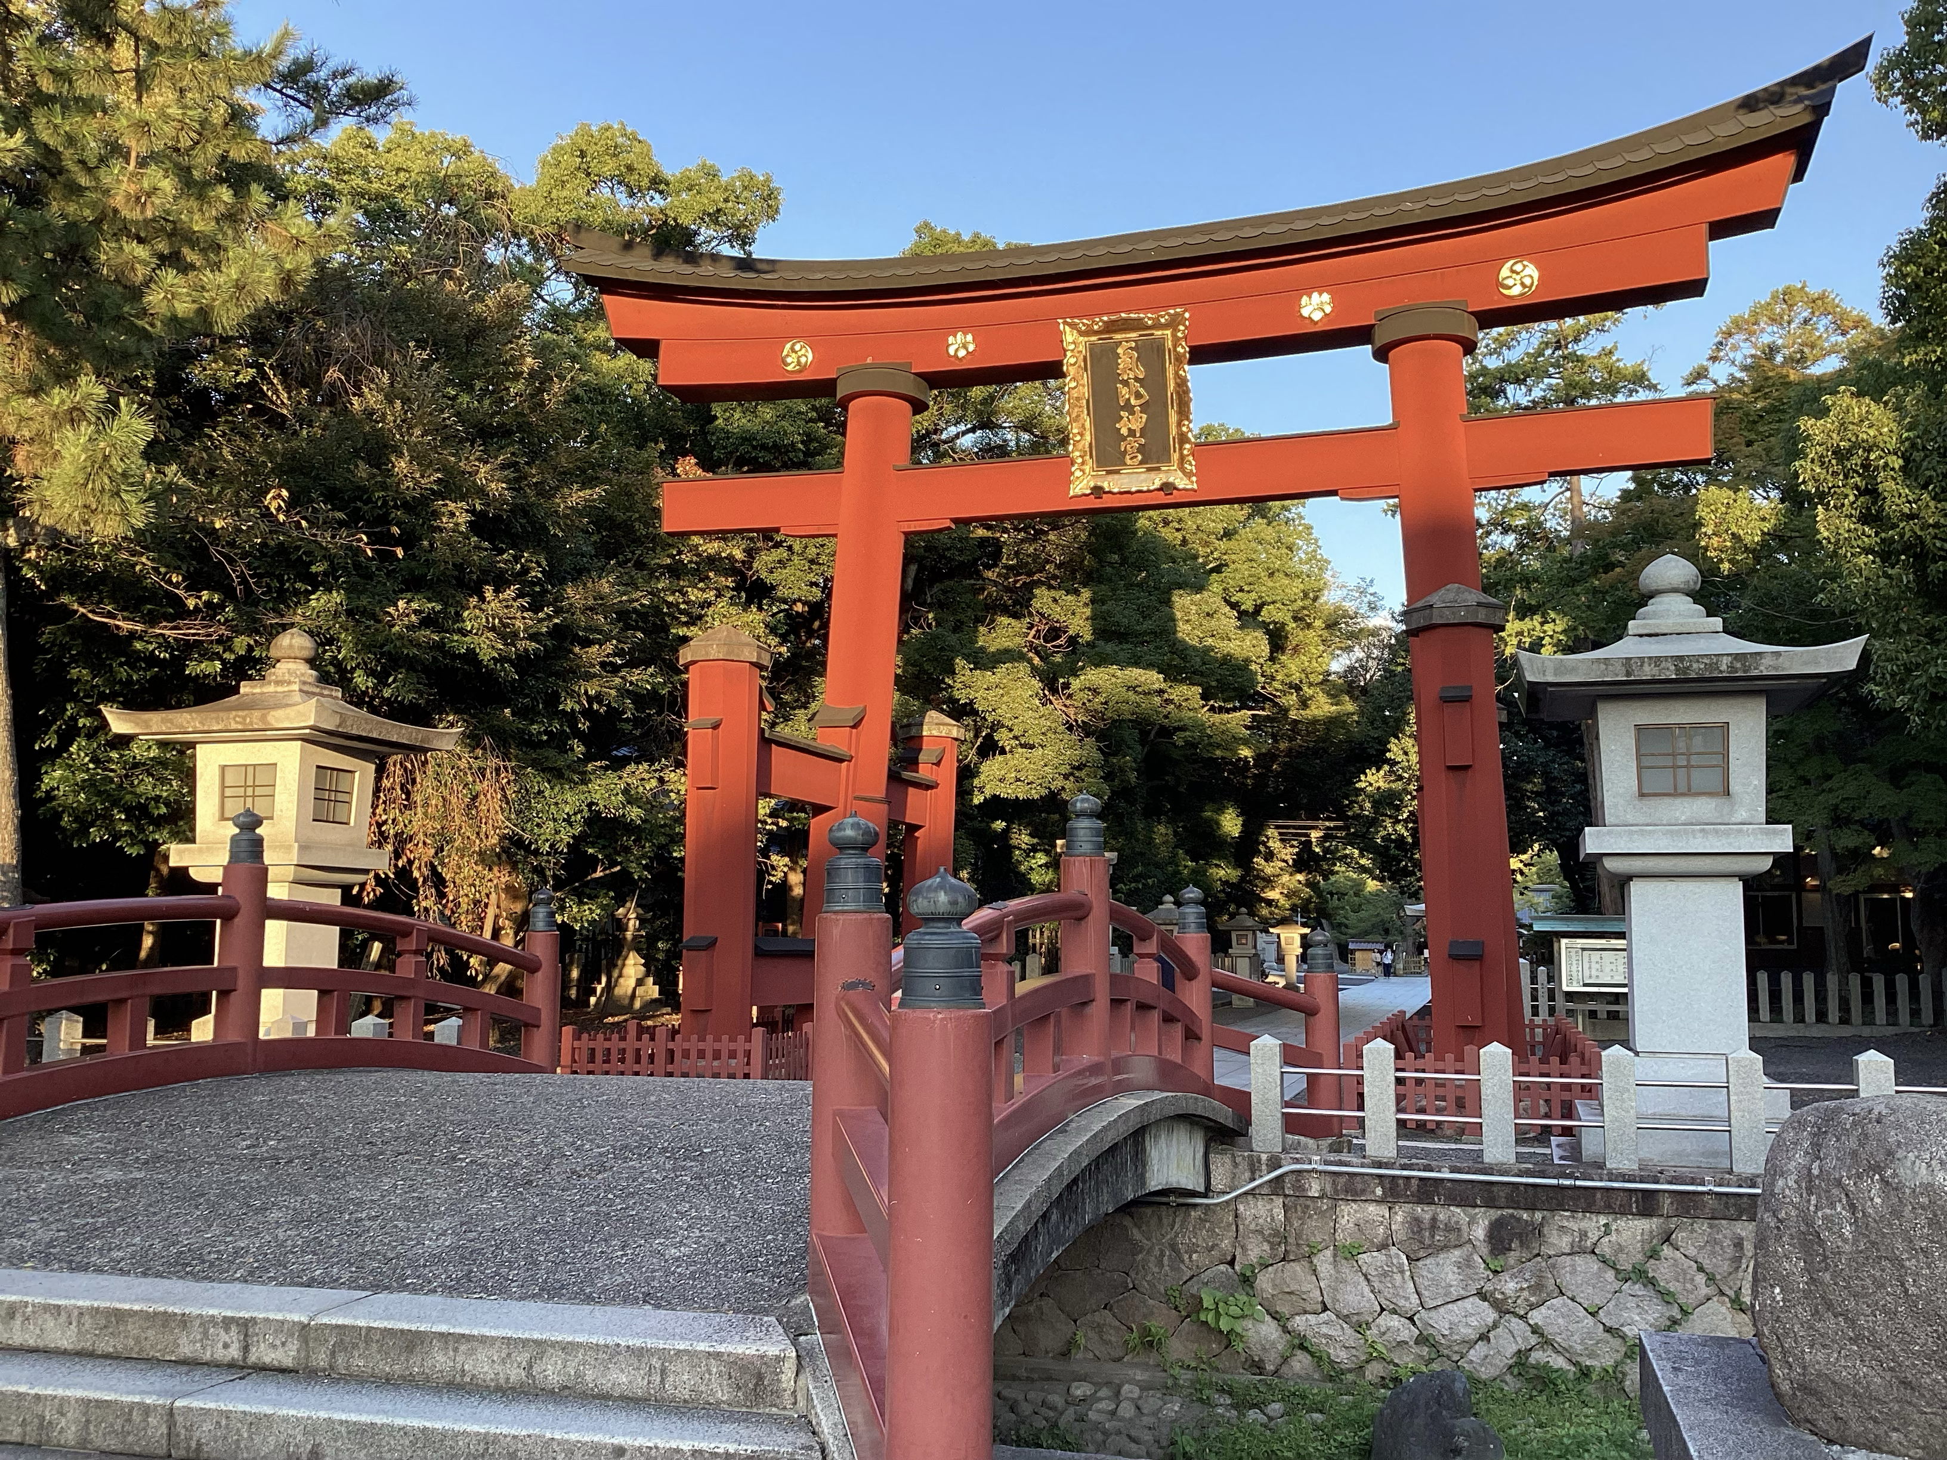
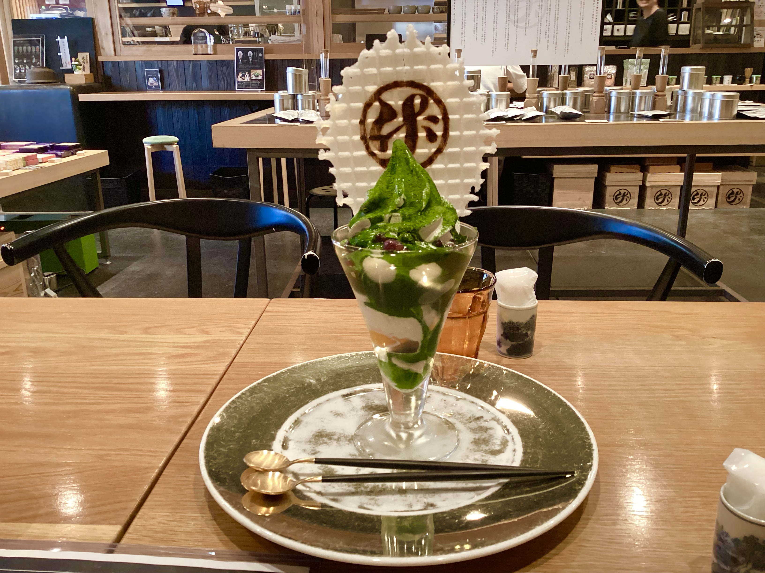
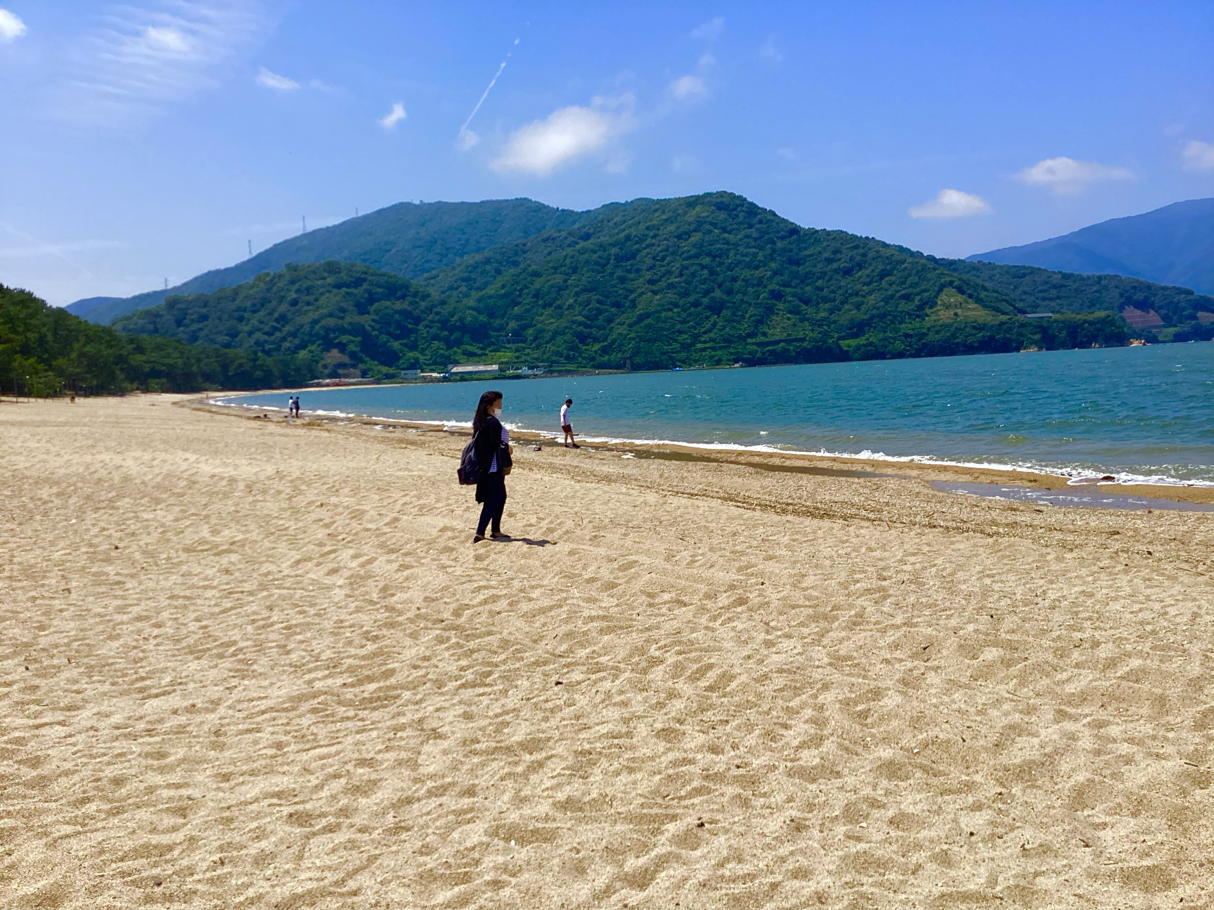
Activity details
We produce brochures that introduce tourist spots and souvenirs of Tsuruga for tourists.

Slide 3
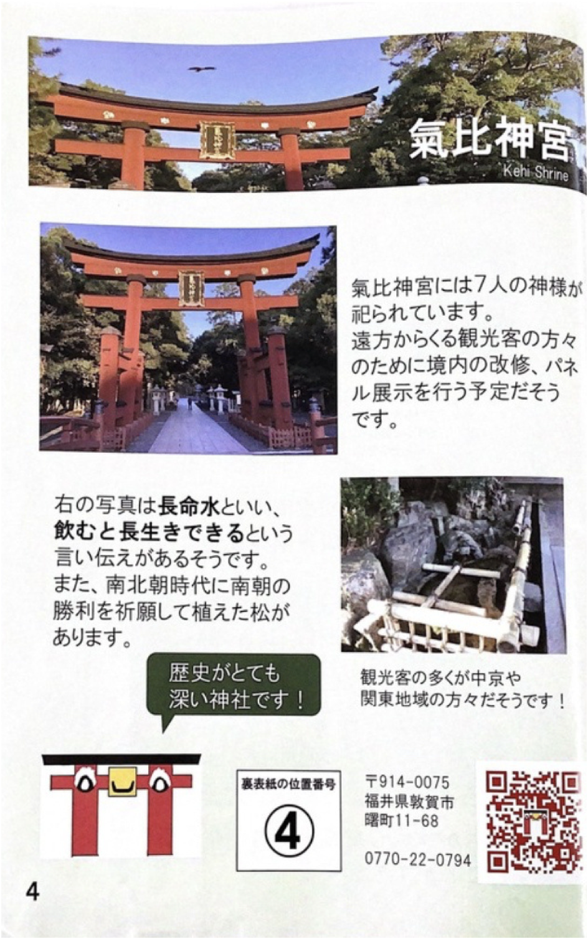
Differences between the old brochure and the new brochure
2024
Simple
Long passage

Slide 4
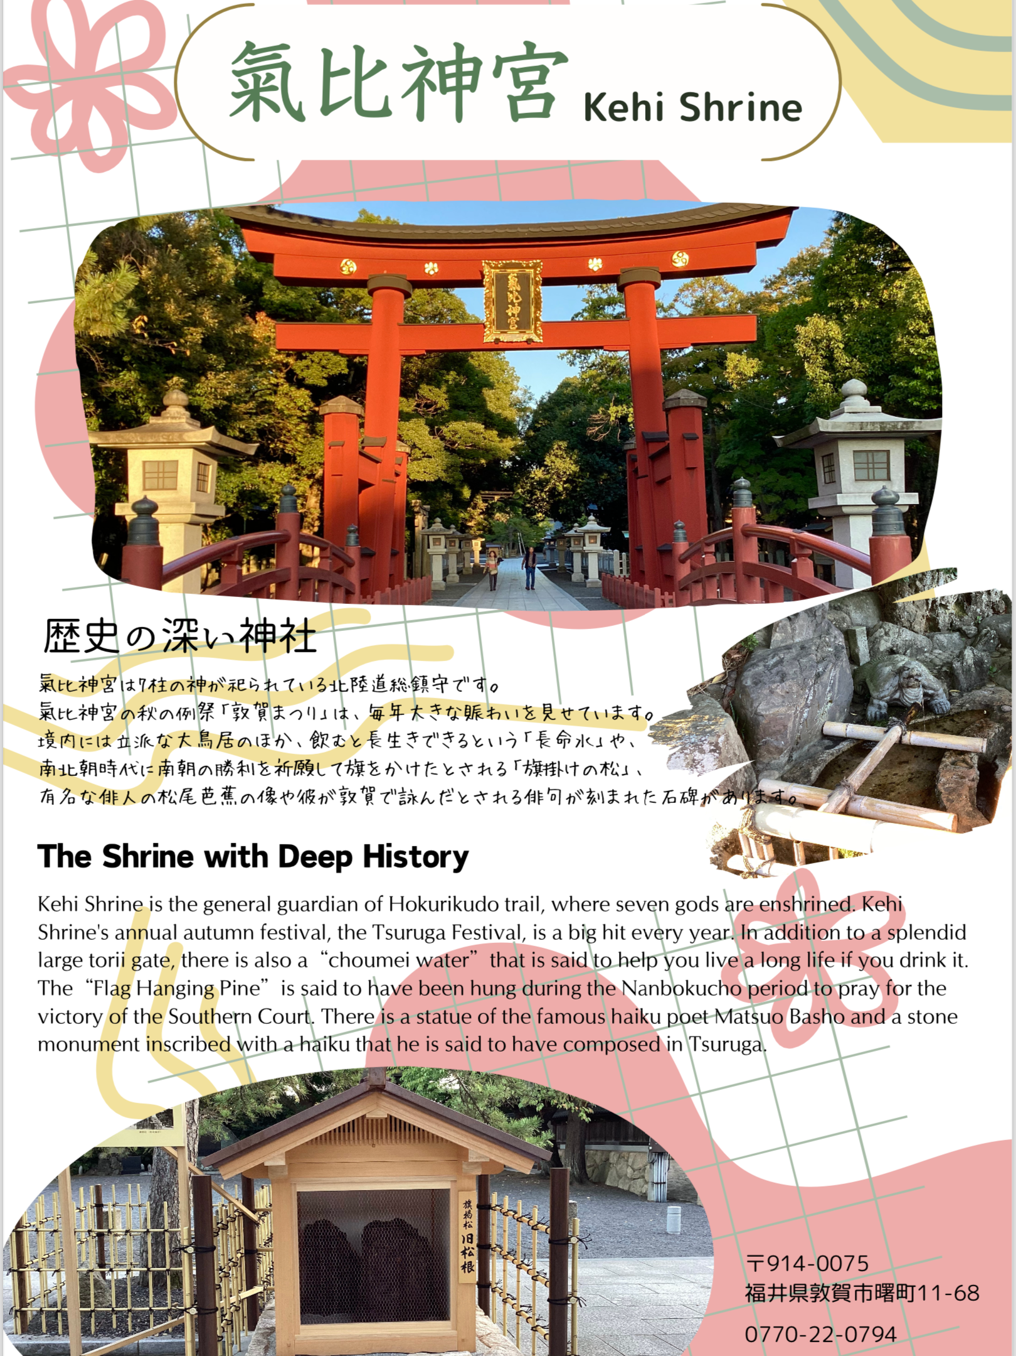
Differences between the old brochure and the new brochure
2025
Made the background vivid
Added
English passage

Slide 5
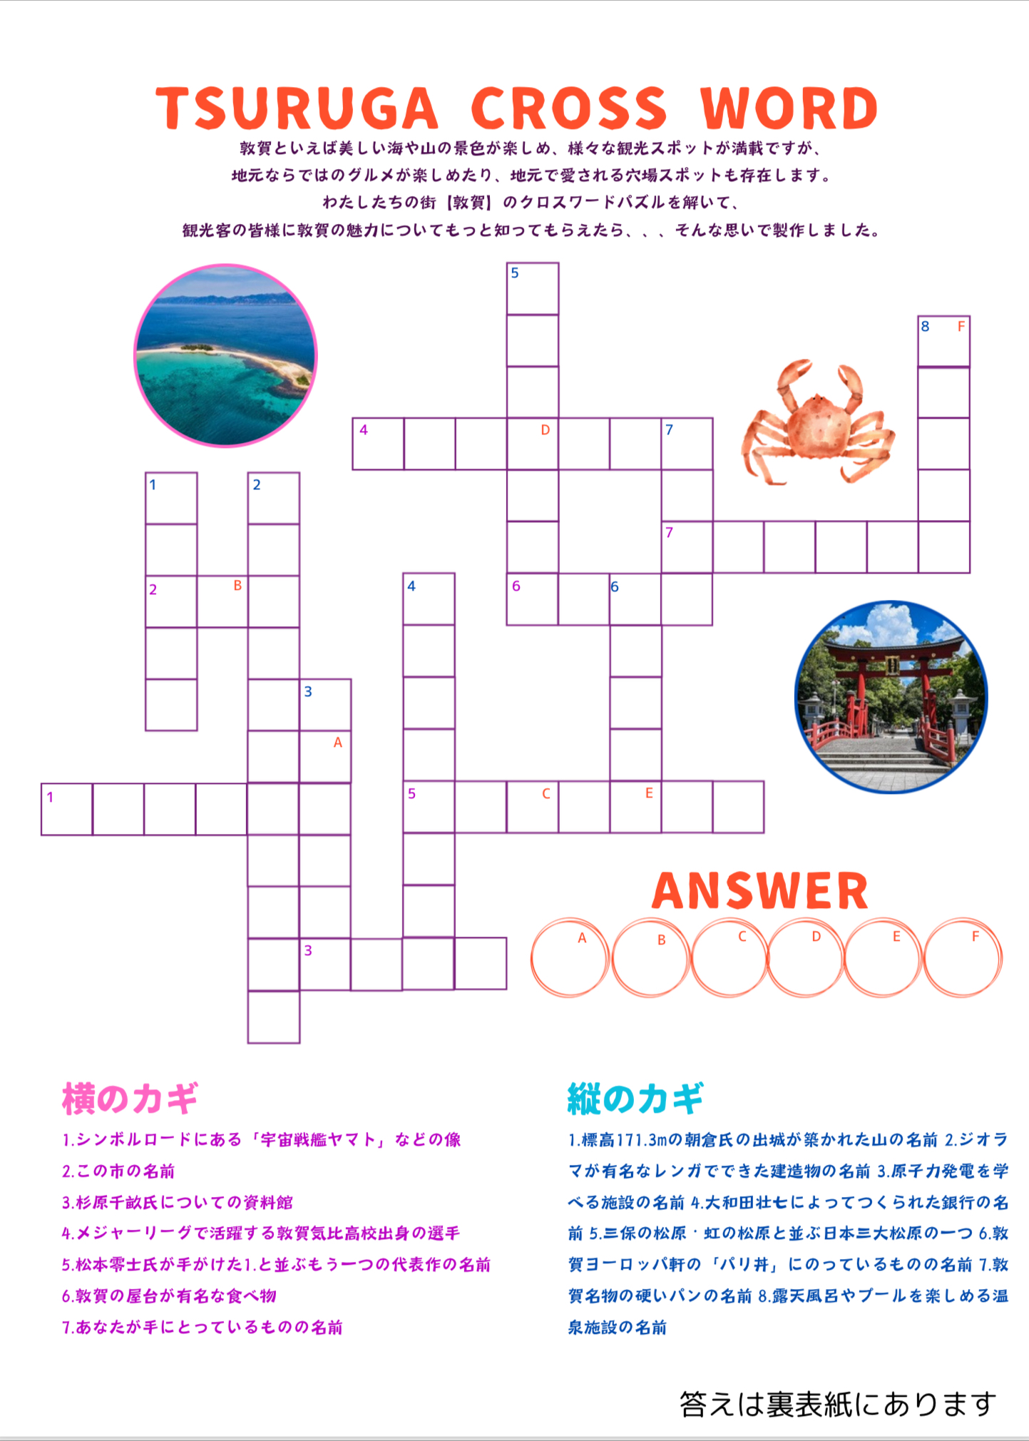
Added pages
Crossword

Slide 6
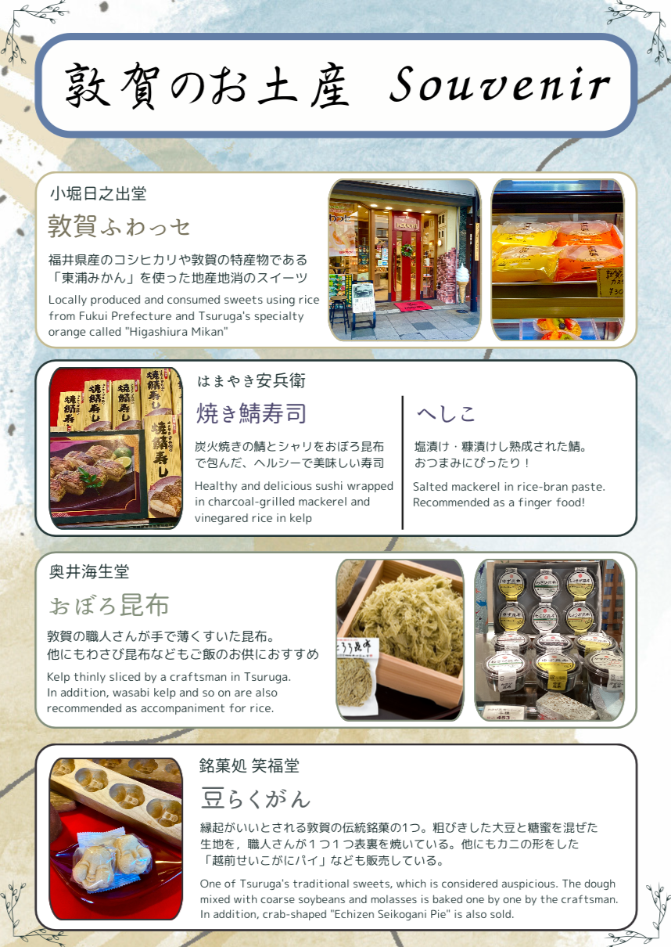
Added pages
Souvenir page

Slide 7























Thank you so much!

